Slide 1

Predicting Diabetes: A Comparative Study of Machine Learning Algorithms for Classification
Name :
Hemlatha Kaur Saran
Raminder Singh
George David Asirvatharaj

Slide 2
Project Contribution By
Each Team Member
Hemlatha Kaur Saran
Dataset selection, Data cleaning and preparation
Performing Exploratory Data Analysis (EDA)
Summary Statistics table , Univariate Analysis , Box plot Distribution
Raminder Singh
Correlation Matrix,
Show target class distribution, visualise categorical variables
Train logistic Regression model , Train Random Forest Classifier
George David Asirvatharaj
Train XGBoost Classifier
Train K-Nearest Neighbors, Feature Importance
Hyperparameter Tuning , Conclusion

Slide 3
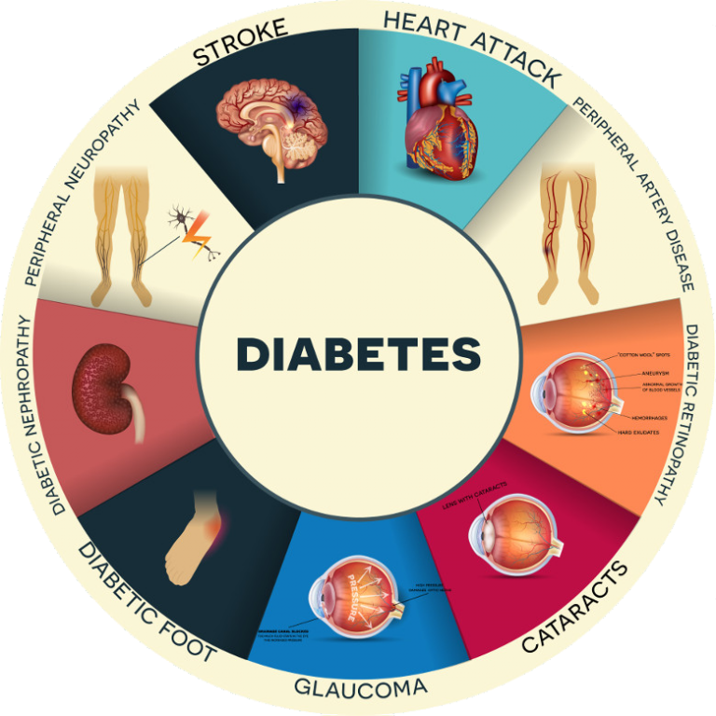

Overview of Diabetes
Diabetes is a global health challenge affecting over 420 million people
Over 9% of the global population suffers from diabetes, with the number rising annually
Diabetes leads to complications such as heart disease, kidney failure, and blindness
The increasing prevalence puts a significant burden on healthcare systems worldwide
Notes:
Diabetes is a significant problem to the health of the world, where more than 420 million sufferers are observed. It is a severe issue as it causes complications, such as heart disease and kidney failure (World, 2024). Because the worldwide diabetes rates keep increasing, it leads to more challenges to healthcare facilities, and, therefore, it is necessary to identify the issue and manage it as soon as possible.

Slide 4


Machine Learning in Healthcare
Machine learning has transformed healthcare by enabling predictive tools for disease diagnosis
These models analyze vast amounts of medical data for better diagnostic accuracy
Machine learning helps in predicting chronic diseases like diabetes before symptoms appear
Early detection models improve patient outcomes and allow for personalized treatment plans
Notes:
Machine learning is transforming the medical industry, as it is now possible to predict diseases early enough. It assists healthcare workers in processing enormous data in a more accurate way (Olalekan Kehinde, 2025). In the case of diabetes, it is also possible to predict the onset of the disease much earlier than the symptoms, so with the machine learning models, a more personalized, timely intervention will occur with better patient outcomes.

Slide 5
Purpose and Objectives
The study aims to predict diabetes using machine learning models
The dataset includes features such as age, BMI, blood glucose levels, and more
The evaluation will focus on accuracy, precision, recall, F1 score, and ROC AUC
The main objective is to compare the performance of four machine learning models
Notes:
This study aims to use machine learning to predict diabetes. We hope to gauge the performance of different models using important metrics, which are accuracy, precision, recall, and F1 score. Four models will be used to compare the study, namely logistic regression, random forest, XGBoost, and KNN, as the best models to use in the research task.

Slide 6
Dataset Overview
The dataset is sourced from publicly available healthcare data (Kaggle) on diabetes
It includes 100,000 observations with 8 features like age, gender, and BMI
The target variable is binary: 1 for diabetic and 0 for non-diabetic
This large sample size allows for robust model training and testing
Notes:
The size of the dataset is 100,000 records and 8 features, which consist of age, gender, hypertension, BMI, etc. (Basith et al., 2019). The target variable contains the presence of diabetes (1) or lack of diabetes (0) of a person. Such a large dataset makes any comparison of different machine learning algorithms thorough, and it leads to reliable results since this sample is big enough to train models.

Slide 7
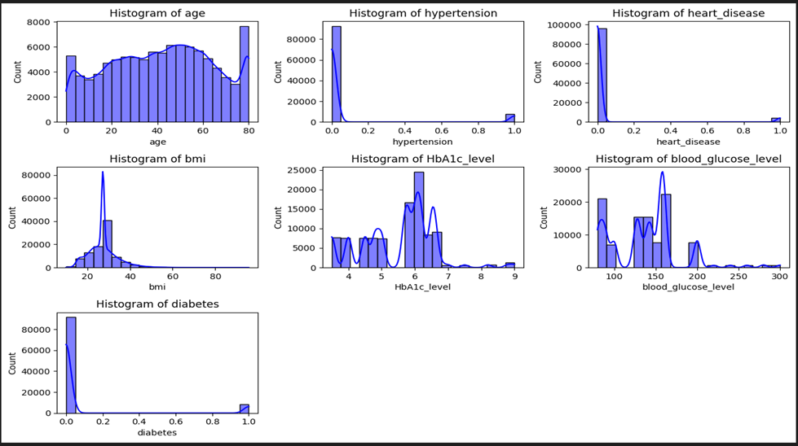
Exploratory Data Analysis (EDA)
Initial data inspection reveals the dataset’s structure and distribution
Visualizations like histograms help identify feature distributions and class imbalance
Box Plot in EDA helps to identify outliers, Visualize Spread of data , check for skewness, compare groups.
Correlation matrix explores relationships between features
EDA helps in identifying patterns and preparing the dataset for model training
Notes:
During the EDA process, we examine the structure of the data set and the features. Histograms and similar visualizations allow you to see the distribution of such features as BMI and blood glucose. The correlation matrix enables us to find which features are closely connected with diabetes, and it also assists us in picking the main predictors to train the models.

Slide 8
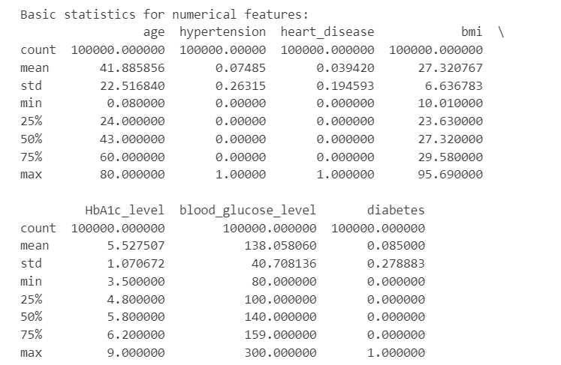
Summary Statistics Table
A summary statistics table for a diabetes dataset gives a quick numberical overview of each variable so you can spot patterns , missing values , or unusual data before doing ML.
Detects impossible values ( eg – Glucose =0)
Shows Data Spread ( Helps in scaling)
Highlights Outliers ( Very High insulin values)
Tells if variables are skewed ( mean *median)

Slide 9
Univariate Analysis
The age distribution shows a concentration of middle-aged individuals
BMI shows a peak in the overweight or obese range, indicating potential risk factors
Blood glucose levels show a distinct separation between diabetic and non-diabetic individuals
The target variable is highly imbalanced, with more non-diabetic cases
Notes:
Univariate analysis gives information regarding the distribution of individual features. Age demonstrates that diabetic attacks middle-aged people the most. The distribution of the BMI in evidence shows that diabetics have the tendency of high BMI values. The ability to measure blood glucose shows a definite difference between diabetics and diabetic-free people. There is a clear disparity between the target variable classes, with the cases of non-diabetes predominating.

Slide 10


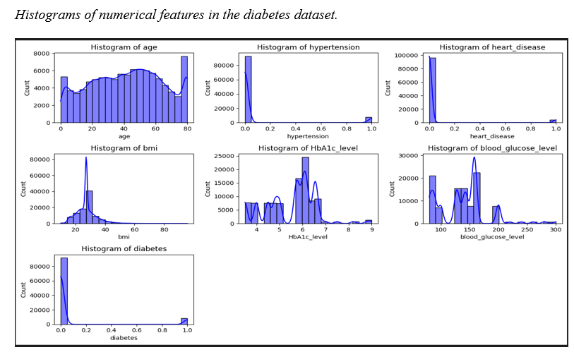

Univariate Analysis
. The histograms show graphically the number of occurrences of numerical data like age, BMI, HbA1c, and blood glucose levels. The age attribute has a maximum at 50 years, signifying that many of the people would be in middle age. The BMI shows a high peak of 30 that indicates more people are overweight or obese. The concentration of HbA1c level is maximized at 6 with some elevated measurements. The concentration of blood glucose has been highly concentrated between 100 and 150 mg/dL. The distribution of diabetes is very skewed, as the cases of non-diabetes are bigger in number.
The target variable, diabetes, shows a highly imbalanced distribution with more non-diabetic cases than diabetic ones.
Notes:
Note. The histograms illustrate the distribution of numerical variables such as age, BMI, HbA1c level, and blood glucose level. The target variable, diabetes, shows a highly imbalanced distribution with more non-diabetic cases than diabetic ones.

Slide 11
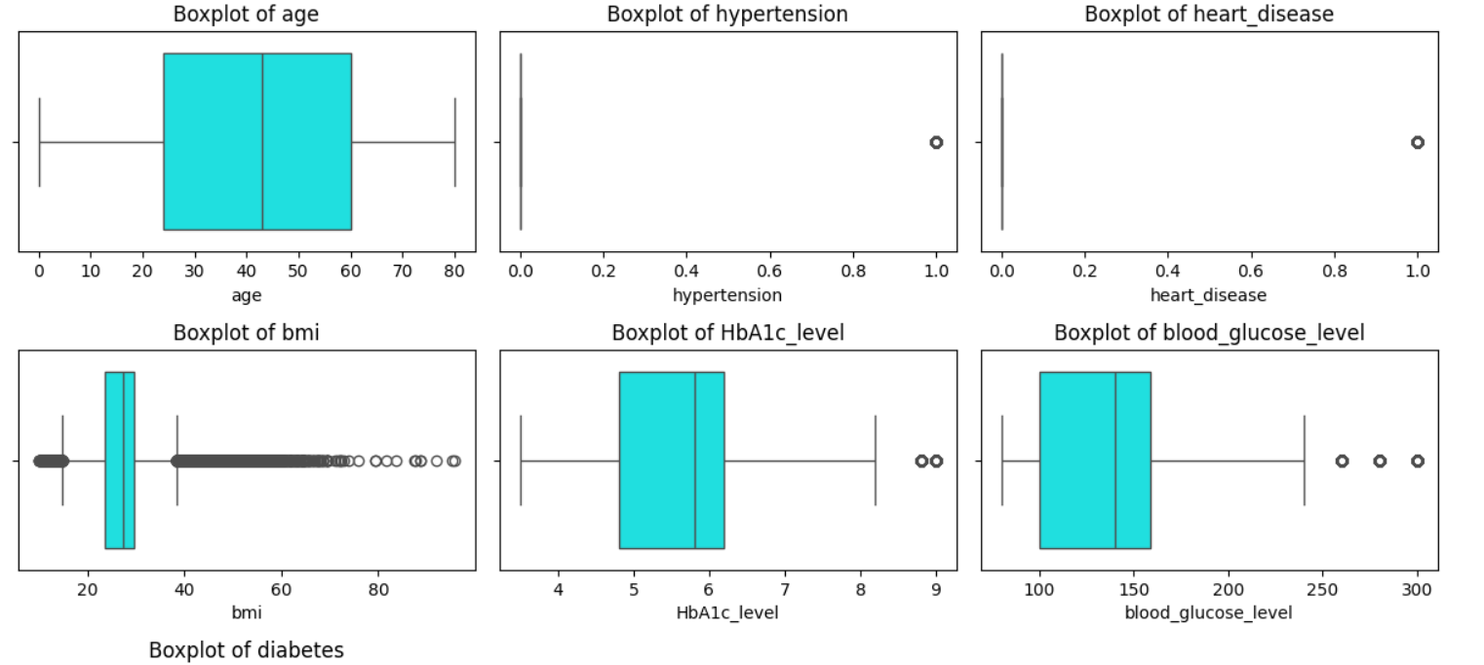
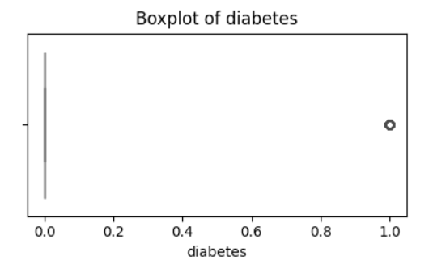
Box Plot For Diabetes Data Set
Notes:
Box Plot in EDA helps to identify outliers, Visualize Spread of data , check for skewness, compare groups.

Slide 12
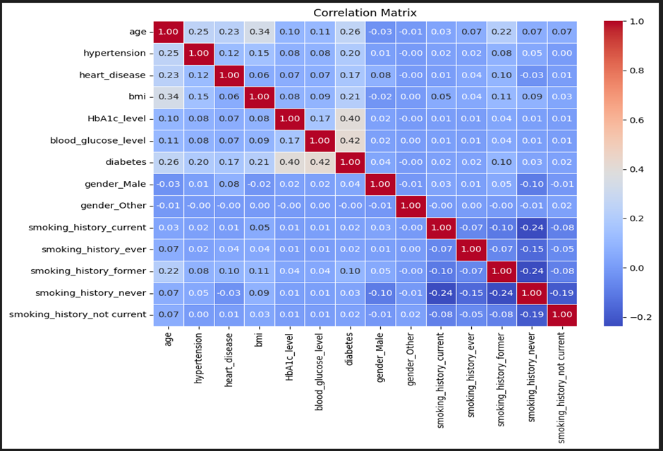
Correlation and Feature Relationships
Blood glucose and HbA1c levels are strongly correlated (0.42)
Moderate correlation between diabetes, age (0.26) and BMI (0.21)
Correlation analysis reveals key predictors for diabetes prediction
Understanding relationships between features is crucial for model selection
Notes:
Using correlation, the analysis depicts that the concentration of blood glucose is strongly associated with the concentration of HbA1c, which implies that they are both essential in predicting diabetes. It is also observed there are moderate correlations between diabetes and age, as well as BMI, showing that they increase the chances of occurrence of this disease. It is significant to identify such relationships when training the best model features.

Slide 13
Data Preprocessing
Missing values are imputed using the mean for numerical and mode for categorical features
Outliers are detected using the IQR method and managed accordingly
Numerical features are standardized using StandardScaler
These steps ensure clean, consistent data for accurate model performance
Notes:
Preprocessing of the data is also crucial in this regard so as to ensure that our models are trained on trustworthy data. Imputation techniques apply in the management of missing values, and mean would be used in a numerical variable and mode would be used as a categorical. Numerical features are standardized by use of the IQR rule to determine outliers and guarantee that all features have equal contribution in the training. The measures improve the precision and validity of the models.

Slide 14


Feature Engineering
Categorical variables like gender and smoking history are encoded using one-hot encoding
The transformation splits categories into binary columns for each class
Feature engineering improves the model’s ability to handle categorical data
This step ensures that all data is in a suitable format for machine learning
Notes:
Encoding categorical data as a series of binary columns is known as feature engineering and is undertaken using one-hot encoding. In a case example, gender is divided into two columns as either being male or other. The history of smoking is also coded into individual binary columns. The change enables this model to handle categorical data in an effective manner, whereby the transform process ensures that all variables are in a form usable during the training process.

Slide 15
Models & Evaluation Metrics
Metrics | Description
Accuracy | How often the model is correct overall. If the model predicts correctly 90 times out of 100, Accuracy = 90%.
Precision | When the model says “Positive”, how often is it actually correct? If your model predicts 50 emails are spam, but only 40 are truly spam: Precision = 40 / 50 = 0.8 (80%)
Recall | Out of all actual positives, how many did the model correctly catch? If there are 100 patients with a disease and your model detects 90, Recall = 90 / 100 = 0.9 (90%)
F1 Score | Harmonic mean of Precision and Recall — balances both. If Precision = 0.8 and Recall = 0.9 > F1 = 0.847
ROC AUC | Probability the model ranks a random positive higher than a random negative. AUC = 0.95 means 95% ranking accuracy.
Logistic Regression
Random Forest
XGBoost
KNN
Notes:
Logistic Regression It is one of the most famous binary classifications, which is applied when the data can be linearly separated. It can be interpreted because it estimates the likelihood of an outcome with regard to input features. Since this model is simple and understandable when it comes to knowing the impact of each feature on the prediction, it is useful in making a baseline comparison.

Slide 16
Logistic Regression Overview
Logistic Regression is a binary classification model based on probability
It is interpretable and provides insights into the relationship between features and diabetes
Suitable for linearly separable data
Simple and effective for baseline model comparison
Notes:
Logistic Regression It is one of the most famous binary classifications, which is applied when the data can be linearly separated. It can be interpreted because it estimates the likelihood of an outcome with regard to input features. Since this model is simple and understandable when it comes to knowing the impact of each feature on the prediction, it is useful in making a baseline comparison.

Slide 17
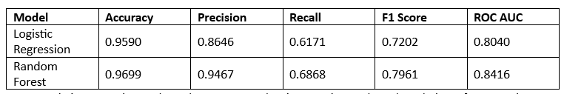
Logistic Regression Model Evaluation
The model correctly predicted the diabetes status for 95.90% of the cases in the dataset.
Precision of 86.46% indicates that the model correctly identified 86.46% of the predicted diabetic cases.
With a recall of 61.71%, the model identified 61.71% of actual diabetic patients.
The F1 score of 0.7202 shows a balanced trade-off between precision and recall
An ROC AUC of 0.8040 suggests the model has good ability to distinguish between diabetic and non-diabetic cases.
Notes:
A high accuracy of 95.90% was attained by the logistic regression model. But 61.71 percent recall shows that it overlooks most cases of diabetes. Its precision of 86.46 is rather good, and the F1 score of 0.7202 identifies a balance between the precision and recall. An ROC AUC of 0.8040 demonstrates that the model is capable of differentiating between diabetic and non-diabetic; still, it is possible to improve it.

Slide 18
Random Forest Overview
Random Forest is an ensemble method that uses multiple decision trees
It aggregates results from multiple trees for robust predictions
The model is capable of capturing complex patterns in data
It helps identify feature importance, providing insight into predictors
Notes:
Random Forest is an ensemble machine learning algorithm that constructs and then melds numerous decision trees to create better forecasts. This method makes the model deal with both linear and nonlinear relations. Random Forest also gives us feature importance, giving us the best features that enable us to predict diabetes.

Slide 19
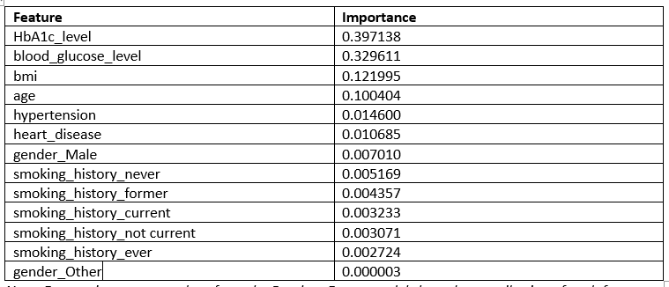
Random Forest Model Evaluation
The Random Forest model correctly predicted 96.99% of the cases in the dataset.
The model correctly identified 94.67% of the positive predictions as diabetic cases.
The recall of 68.68% indicates that the model correctly identified 68.68% of actual diabetic patients.
An F1 score of 0.7961 reflects a strong balance between precision and recall.
The ROC AUC score of 0.8416 shows the model's good ability to distinguish between diabetic and non-diabetic cases.
Notes:
The Random Forest, when used, performed very well with an accuracy of 96.99%. Its 94.67 precision level means that it made a fairly high number of accurate positive predictions, and its recall level of 68.68 means that it had found more diabetic cases as compared to logistic regression. The F1 score of 0.7961 shows a good tradeoff between the precision and recall, and the ROC AUC of 0.8416 shows that the model has good discriminative power.

Slide 20
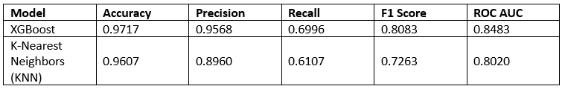
XGBoost Model Evaluation
The XGBoost model correctly predicted 97.17% of the cases.
The model correctly identified 95.68% of the positive predictions as diabetic cases.
The recall of 69.96% indicates that the model correctly identified 69.96% of actual diabetic patients.
An F1 score of 0.8083 shows a good balance between precision and recall.
The ROC AUC of 0.8483 reflects the model’s strong ability to discriminate between diabetic and non-diabetic cases.
Notes:
XGBoost performed better than the other two models with an accuracy level of 97.17 percent and precision of 95.68 percent. Its sensitivity of 69.96% implies that it can be good at detecting diabetic patients. The F1 is 0.8083, indicating a good balance between precision and recall, and, moreover, the ROC AUC is 0.8483, indicating the good results of distinguishing between diabetic and non-diabetic persons.

Slide 21
K-Nearest Neighbors (KNN) Model Evaluation
The KNN model correctly predicted 96.07% of the cases in the dataset.
The model correctly identified 89.60% of the predicted diabetic cases.
The recall of 61.07% indicates that the model identified 61.07% of the actual diabetic patients.
An F1 score of 0.7263 reflects a moderate balance between precision and recall.
The ROC AUC of 0.8020 shows the model’s ability to distinguish between diabetic and non-diabetic cases.
Notes:
KNN was used as a backbone model, and its accuracy measure was good, that is, 96.07%. But the recall of 61.07 percent used by it shows that it does not capture most of the cases of diabetics, and so its usability in medical forecasting is restricted. A precision of 89.60 is quite good, but an F1 score of 0.7263 also indicates that there is some room to improve, especially in balancing between precision and recall. The performance of the ROC AUC with the value of 0.8020 is satisfactory.

Slide 22
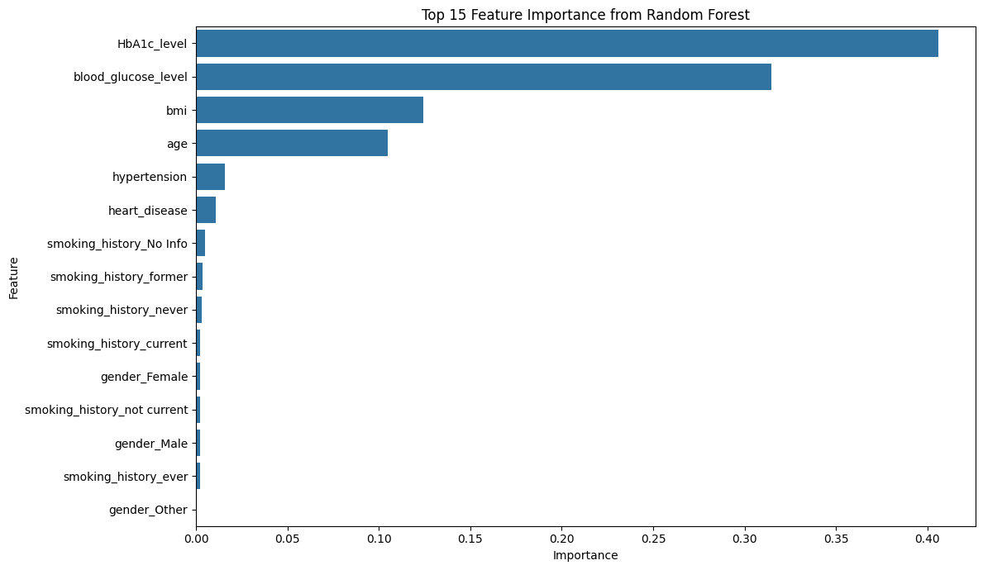
Feature Importance from Random Forest
Feature Importance provides:
1. Interpretability: It provides a clear, data-driven answer to the features that play significant role in the prediction
2. Feature Selection: It helps you identify features that are not contributing to the model's performance.
3. Validation: The results of the feature importance analysis can either validate your assumptions about the data or reveal surprising insights
Notes:
KNN was used as a backbone model, and its accuracy measure was good, that is, 96.07%. But the recall of 61.07 percent used by it shows that it does not capture most of the cases of diabetics, and so its usability in medical forecasting is restricted. A precision of 89.60 is quite good, but an F1 score of 0.7263 also indicates that there is some room to improve, especially in balancing between precision and recall. The performance of the ROC AUC with the value of 0.8020 is satisfactory.

Slide 23
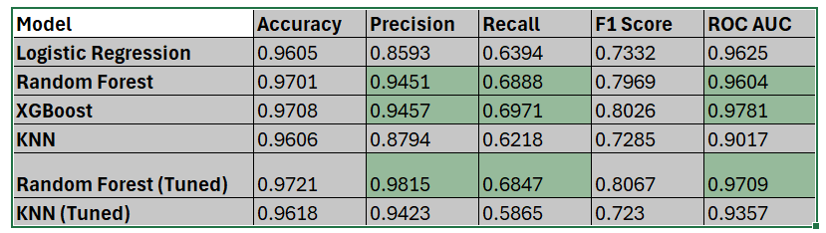
Final Evaluation with tuned models
XGBoost has higher ROC AUC and Recall and good in distinguishing between the two classes and is also the most effective at identifying the actual positive cases (diabetic patients)
Random Forest Tuned is the next closest to have a high ROC AUC and Recall
Notes:
KNN was used as a backbone model, and its accuracy measure was good, that is, 96.07%. But the recall of 61.07 percent used by it shows that it does not capture most of the cases of diabetics, and so its usability in medical forecasting is restricted. A precision of 89.60 is quite good, but an F1 score of 0.7263 also indicates that there is some room to improve, especially in balancing between precision and recall. The performance of the ROC AUC with the value of 0.8020 is satisfactory.

Slide 24
Conclusion
XGBoost and Random Forest outperformed other models
XGBoost achieved the best performance in terms of accuracy and recall
Random Forest offers valuable feature importance insights
Future improvements include deep learning and feature engineering
Notes:
XGBoost and Random Forest performed best, with the most successful accuracy and recall by XGBoost. Random Forest did not fare any worse and provided us with useful information about feature significance. In the future, one can think of adding additional features, like lifestyle data, and can test deep learning models to get even better accuracy in the prediction.

Slide 25

References
World. (2024, November 14). Diabetes. Who.int; World Health Organization: WHO. https://www.who.int/news-room/fact-sheets/detail/diabetes
Olalekan Kehinde. (2025). Machine Learning in Predictive Modelling: Addressing Chronic Disease Management through Optimized... International Journal of Research Publication and Reviews, 6(1), 1525–1539. https://www.researchgate.net/publication/388123356_Machine_Learning_in_Predictive_Modelling_Addressing_Chronic_Disease_Management_through_Optimized_Healthcare_Processes
Basith, A., Hashim, M. J., King, J. K., Govender, R. D., Mustafa, H., & Juma Al Kaabi. (2019). Epidemiology of Type 2 Diabetes – Global Burden of Disease and Forecasted Trends. Journal of Epidemiology and Global Health, 10(1), 107–107. https://doi.org/10.2991/jegh.k.191028.001

